Slide 1
CONSUMER RIGHTS
BY :
1. G.Tejaswi (192211748)
2.Y. Baby Santoshi (192219024)

Slide 2
1.AIM :
A survey based on consumer rights. To give ethical awareness on consumer rights to the people in the society by online survey .

Slide 3
2. ABSTRACT :
Consumer rights are required for every person for purchasing good products. These rights helps in giving information about the products and helps in protecting against unfair practices in trade. This survey was conducted to spread awareness about consumer rights. We came to know that only few were aware of these rights. This survey helps them to know these rights.

Slide 4
3. KEY WORDS :
Competition
Monopoly
Redress
Choose
Information
Safety
Trade
Satisfaction
Consumerism
Quality
Retail Assurance

Slide 5
4. INTRODUCTION :
The definition of Consumer right is ‘the right to have information about the quality, quantity, purity, price and standard of goods or services’, as it may be the case, but the consumer is to be protected against any unfair practices of trade. It is very essential for the consumers to know these rights.
However there are strong and clear laws in India to defend consumer rights. Out of the various laws that have been enforced to protect the consumer rights in India, the most important is the Consumer Protection Act, 1986. According to this law, everybody, including individuals, a firm, a Hindu undivided family and a company, have the right to exercise their consumer rights for the purchase of goods and services made by them.

Slide 6
4.1.Basic Consumer Rights:
Right to Heard
Right to Information
Right to Choose
Right to Safety
Right to Seek
Right to Consumer Education

Slide 7
5.LITERACY SURVEY :
Maylea, Katterl, Johnson, (2021) - Experiences of consumers with rights-based mental health laws: Australian state of Victoria's lessons.
J. Csete, R. Elliott (2021) - The human rights argument for safe supply as a component of harm reduction in drug policy with regard to consumer protection.
J. Hornle (2018) - Global social media vs local values.
J. Baik (Sophia) (2020) - Data privacy.
S. Boeri, M. (2012) - Site selection for recreational demand.
Nash, I. (2021) - Cybersecurity in a Post-Data Environment.

Slide 8
6.METHDOLOGY :
We choose consumer rights for our project. We created a survey for the consumers by using google forms. In this survey we have formed a questionnaire and collected the responses of several people .Total 20 questions were prepared for this survey. The total number of responses received were 105. By using Wikipedia we have collected the information required for the introduction. Through science direct website we choose the articles related to our topic. Then we pasted the article titles in sci-hub to download the articles and gather the information by reading the articles related to consumers.
After getting the people responses in this survey we downloaded the spss tool which is helpful to draw the graph and mean of the responses. The responses have changed according to spss tool to plot the graphs. To know about the people reliability analysis, choose the items which we want to analyze statically, these will be variables. After completing this we have shown the responses in the graph to understand the responses of people involved in the survey and finally we plotted all graphs

Slide 9
6.1.OBJECTIVES :
State the meaning of Consumer.
Explain the concept of Consumer Protection.
Outline the need for Consumer Protection.
Describe the rights and responsibilities of Consumers.
State the main provisions of Consumers Protection Act.
Outline the machinery for settlement of Consumer grievances

Slide 10
7.RESULTS & DISCUSSIONS : 1.data collection : 1.DATA COLLECTIONS :
S.No. | TOPIC | MAX RESPONSES | MIN RESPONSES
1. | To often buy products | 90 | 15
2. | The price should be reasonable for the quantity and quality of the product. | 87 | 18
3. | To buy products designed with environmental betterment. | 91 | 14
4. | Aware of laws to safeguard consumer interest. | 63 | 42
5. | To recommend products to your friends. | 91 | 14

Slide 11
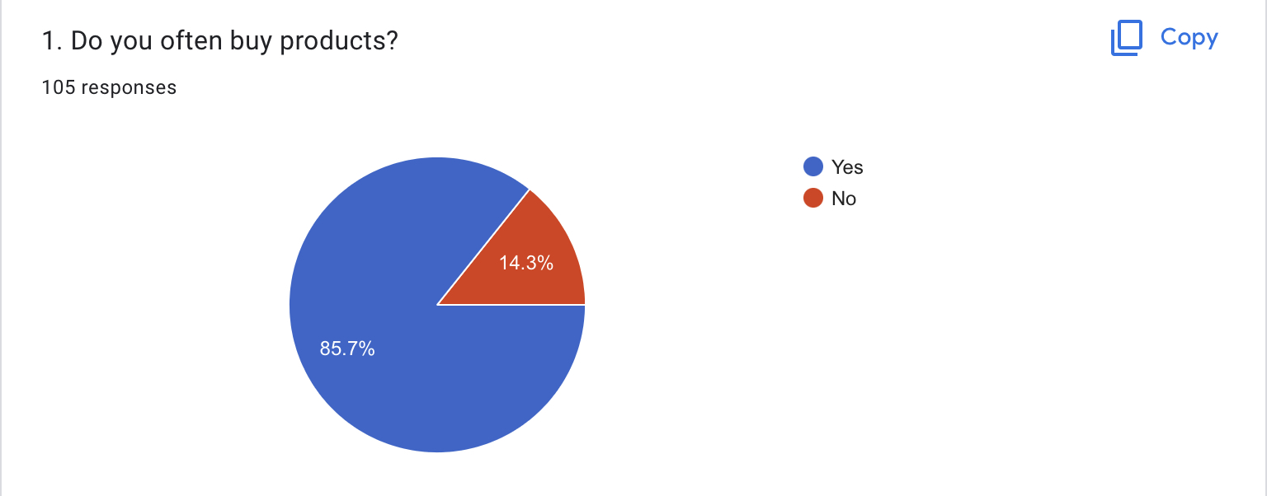
Q-1

Slide 12
Opinion
Many people choose the option yes, as they often buy products . These days many products are available in the market which people often show interest to buy them.

Slide 13
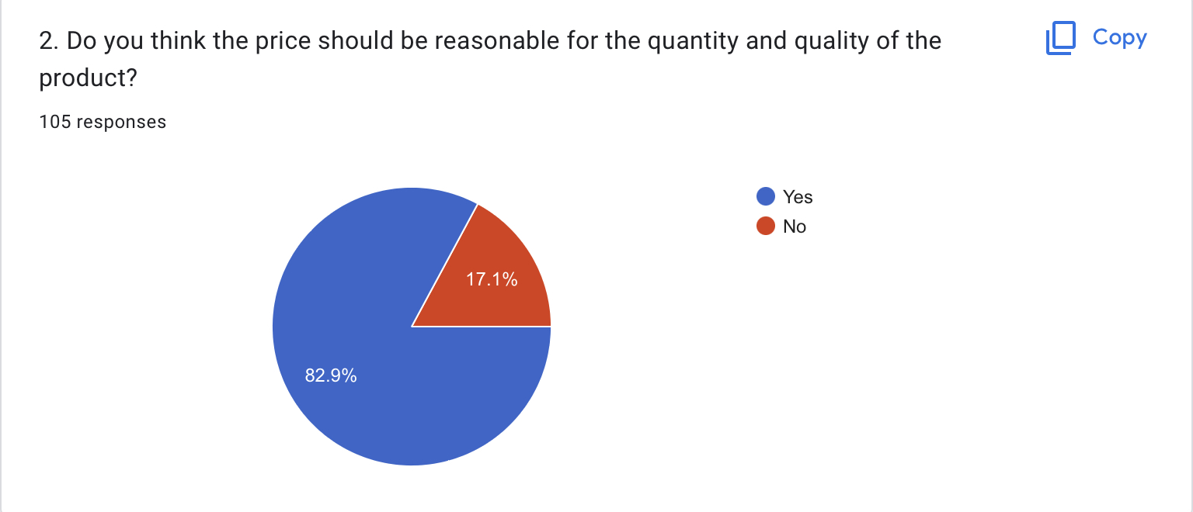
Q-2

Slide 14
Opinion
Majority of the people choose the option yes. Most of the people see quality and quantity before buying any products. They tend to buy products which have reasonable prices.

Slide 15
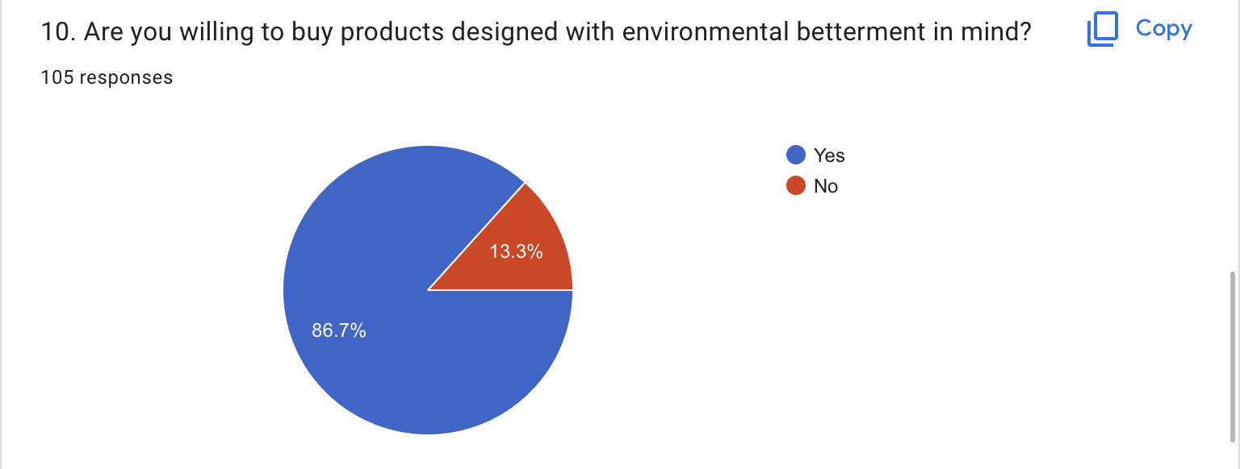
Q-3

Slide 16
Opinion
Majority of them choose yes, as they prefer environmental betterment products. Since pollution has been rapidly increasing many are preferring to buy products which do not harm environment.

Slide 17
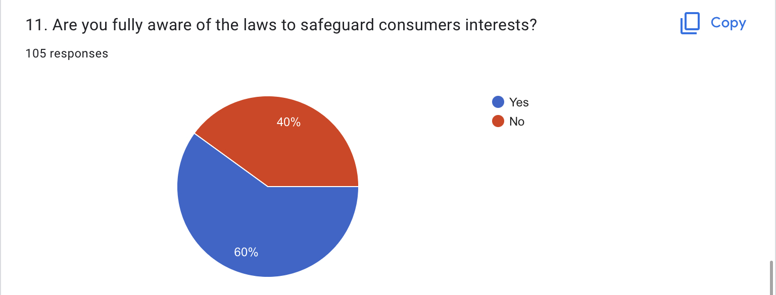
Q-4

Slide 18
Opinion
Most of them preferred yes, but still 40 percent are not aware of it. Awareness regarding laws to safeguard consumers interests must be spread since only some are not aware of it.

Slide 19
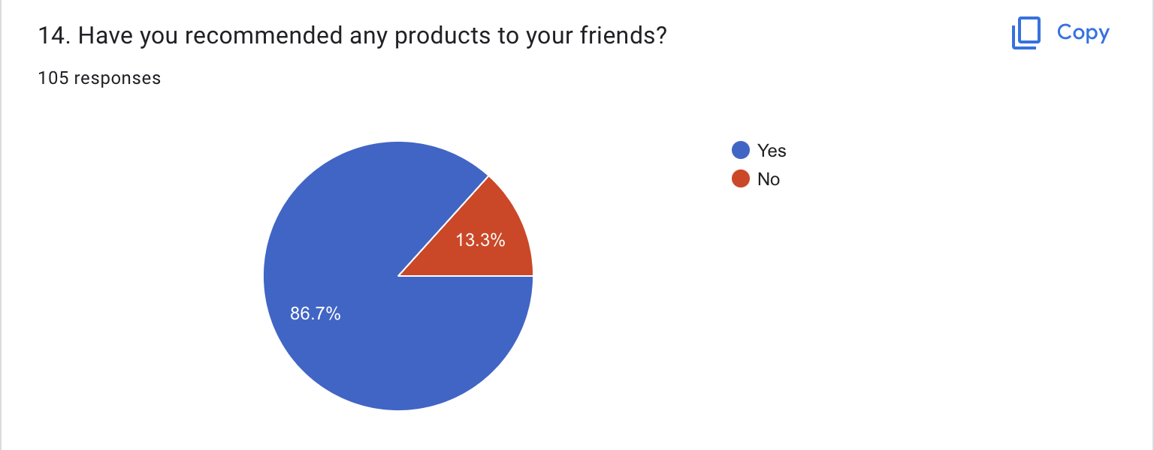
Q-5

Slide 20
Opinion
Majority choose yes , as they prefer in recommending the products which they use to their friends. This helps in increasing profits and marketing of the products.

Slide 21
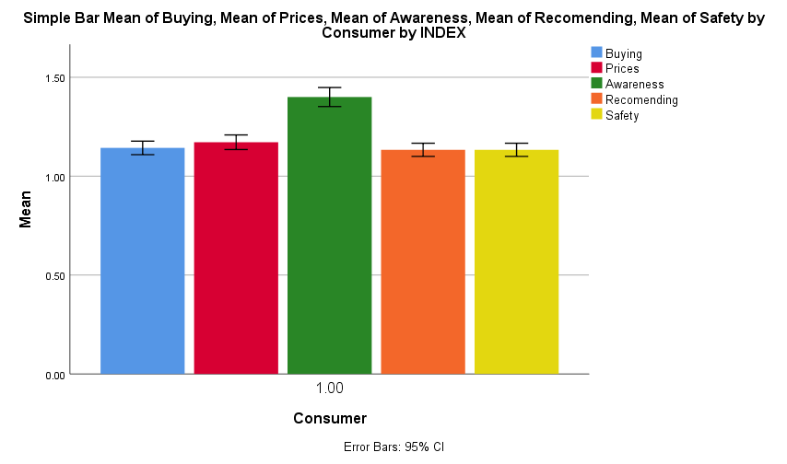
7.2.Graph

Slide 22
8.CONCLUSION :
By conducting this survey we came to conclude that only some are aware of the consumer rights. This requires the people to be educated about this rights to make them vigilant, rational and aware buyers. The government has been fruitful in providing protection to the consumers in real sense of the terms and served the purpose of the act. The rights help in making markets work for both business and consumers. These rights helps the consumers to seek redressal against unfair trade practices and exploitation. These laws are really important as they protect the rights of the consumers.

Slide 23
9.REFERENCE :
It was written by Maylea, Katterl, Johnson, Alvarez-Vasquez, Hill, and Weller (2021). Experiences of consumers with rights-based mental health laws: Australian state of Victoria's lessons. 78, 101737, International Journal of Law and Psychiatry doi:10.1016/j.ijlp.2021.101737.
Goods, C., Barratt, T., and Veen, A. Smith, B. (2020). In Australia's "gig" economy, consumers "app-etite" for workers' rights. Choice Modelling Journal, 100254. doi:10.1016/j.jocm.2020.100254.
J. Csete, R. Elliott (2021). The human rights argument for safe supply as a component of harm reduction in drug policy with regard to consumer protection. 91, 102976; International Journal of Drug Policy. 10.1016/j.drugpo.2020.102976.
J. Hornle (2018). Global social media vs. local values: Should private international law use the public policy exception to safeguard local consumer rights? doi:10.1016/j.clsr.2017.08.008 Computer Law & Security Review, 34(2), 391-397.
Nash, I. (2021). Cybersecurity in a Post-Data Environment: Producer and Consumer Liability in Smart Devices, Code Regulation, and Related Issues. doi:10.1016/j.clsr.2021.105529 Computer Law & Security Review, 40.
Guo, Y.-Y., Chang, H.-H. (2021). The effects of e-retailers' transaction ethics and consumer personalities on online fraudulent returns in Taiwan. 61, 102529, Journal of Retailing and Consumer Services. doi:10.1016/j.jretconser.2021.102529.
Longo, A., Doherty, E., and Hynes, S. Boeri, M. (2012). Site selection for recreational demand: A issue of maximising benefits or minimising regrets? 1(1), 32–47, Journal of Environmental Economics and Policy. https://doi.org/10.1080/21606544.2011.640844.
M. Donnelly, F. White, and (2019). An empirical investigation of supplier compliance with consumer information duties for digital content and consumer protection. doi:10.1016/j.clsr.2019.105343 Computer Law & Security Review, 105343.
J. Baik (Sophia) (2020). Data privacy: Is it a barrier to prejudice or to innovation? : The California Consumer Privacy Act (CCPA). 10.1016/j.tele.2020.101431 10.1016/j.tele.2020.101431 Telematics and Informatics, 52, 101431.
Ethan Katsh and Orna Rabinovich-Einy. (2014). The title of the paper is "Digital Justice: Reshaping Boundaries in an Online Dispute Resolution Environment."

